Slide 1
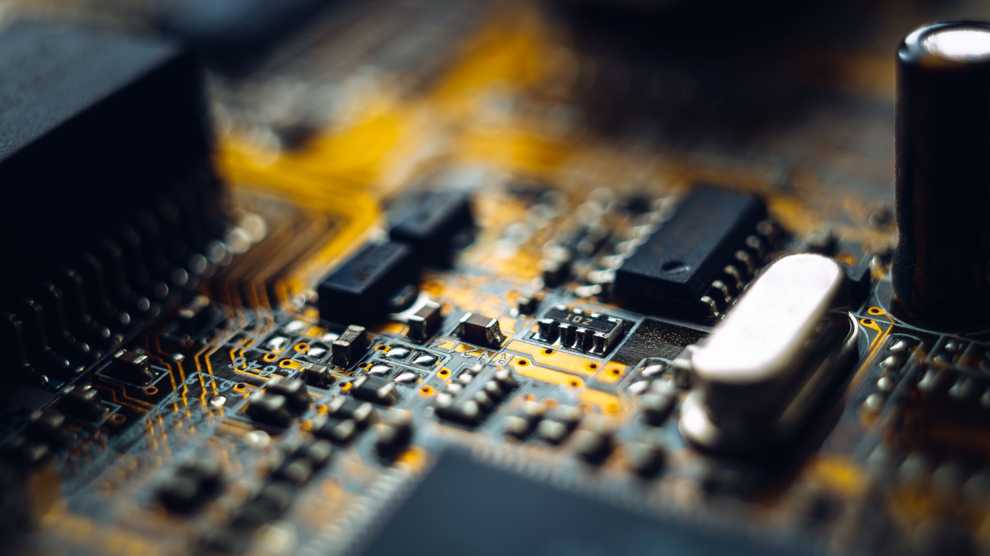
Insights
Module-2 Week-4

Slide 2
Agenda
Synchronization in Distributed Systems - Causality
Vector Clocks Code Walkthrough – Logical Clocks
NTP Protocol Case Study – Quartz Clocks
Google Spanner Case Study – Atomic Clocks

Slide 3
Causality
User-1
User-2
User-3
M1
M2
M2
M1
M1 – Do we understand the Impact of synchronization in distributed systems?.
M2 – Yes, it is very interesting.

Slide 4
Vector Clocks
Initially, all the clocks are set to zero.
On Update, the value of the logical clock in the vector is incremented by 1
Every time an event is received, the value of the logical clock in the vector is incremented by 1, also each node is updated with the “latest” value by comparing the count.

Slide 5

Code Walkthrough

Slide 6
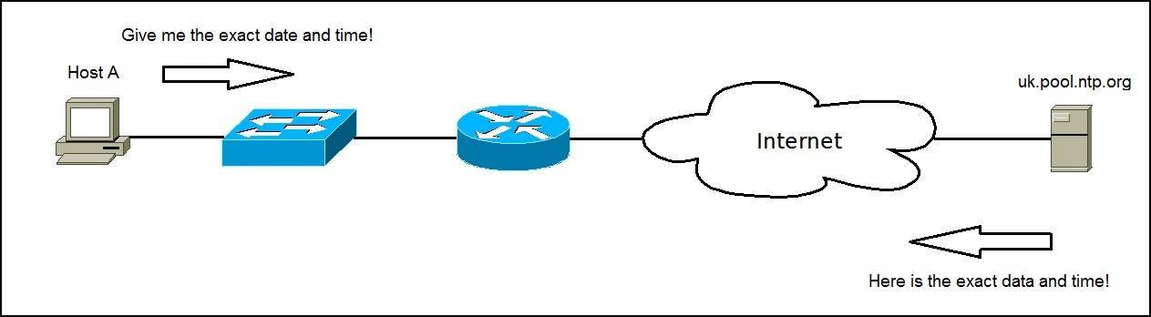
Network Time Protocol

Slide 7
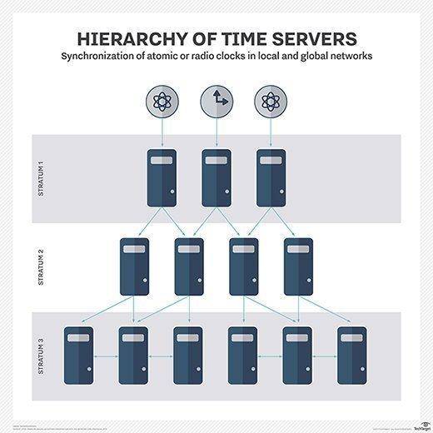
Stratums

Slide 8
Clock Skew
NTP Client
NTP Server
T1
Request : t1
T2
T3
Response : t1, t2, t3
T4

Slide 9
Impact on NTP Synchronization
Snippet-1
long startTime = System.currentTimeMillis();
doSomething();
long endTime = System.currentTimeMillis();
long elapsedMillis = endTime – startTime
Snippet-2
long startTime = System.nanoTime();
doSomething();
long endTime = System.nanoTime();
long elapsedMillis = endTime – startTime

Slide 10
Case Study – Google Spanner
Fully Managed Relational Database Service
Scaled horizontally, Strongly consistent
Spanner automatically distributes data across regions for scaling
Consistency using True Time – System of Atomic Clocks
https://storage.googleapis.com/pub-tools-public-publication-data/pdf/45855.pdf

Slide 11
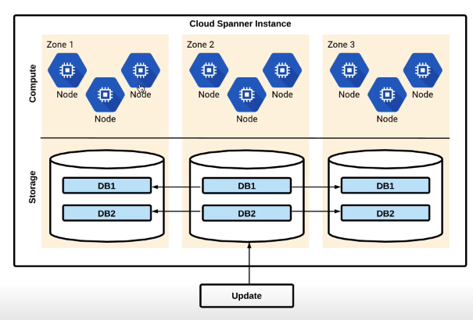
Google Spanner Implementation

Slide 12
Case Study – Google Spanner Cockroach DB
Design Based on Google Spanner Storage System
Open Source, Written in GO ( Spanner is proprietary from google and exporting data from spanner needs skill set more than HBase )
It’s no Brainer Solution for DB Solution ( Eliminates True Time ) - https://www.cockroachlabs.com/blog/living-without-atomic-clocks/
Managed Coakroach DB eliminates the Admin Needs

Slide 13
References
https://storage.googleapis.com/pub-tools-public-publication-data/pdf/45855.pdf
https://www.cockroachlabs.com/blog/living-without-atomic-clocks/
http://www.read.seas.harvard.edu/~kohler/class/cs239-w08/decandia07dynamo.pdf
https://openafs.org/
https://blog.yugabyte.com/evolving-clock-sync-for-distributed-databases/
https://cse.buffalo.edu/tech-reports/2014-04.pdf

